Slide 2
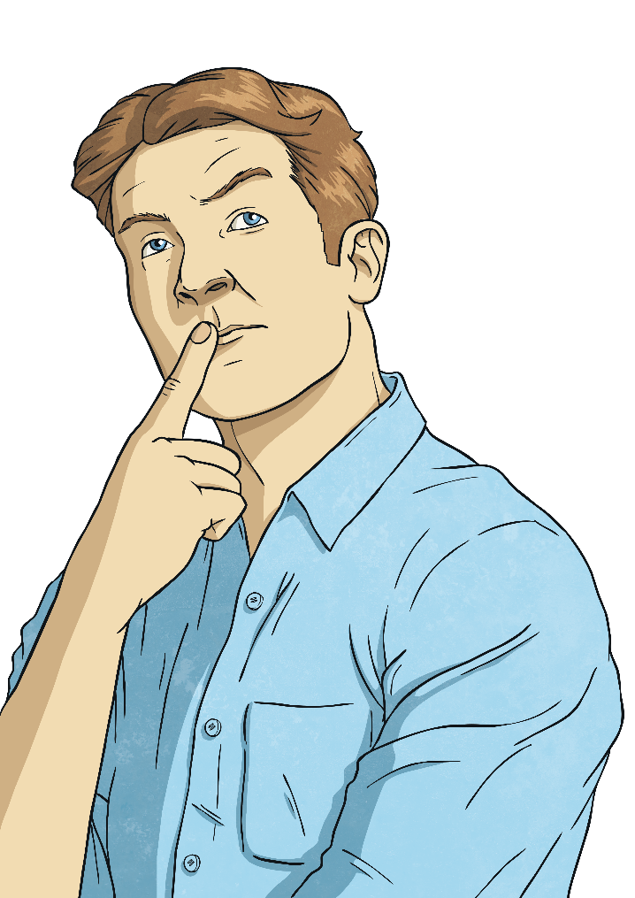

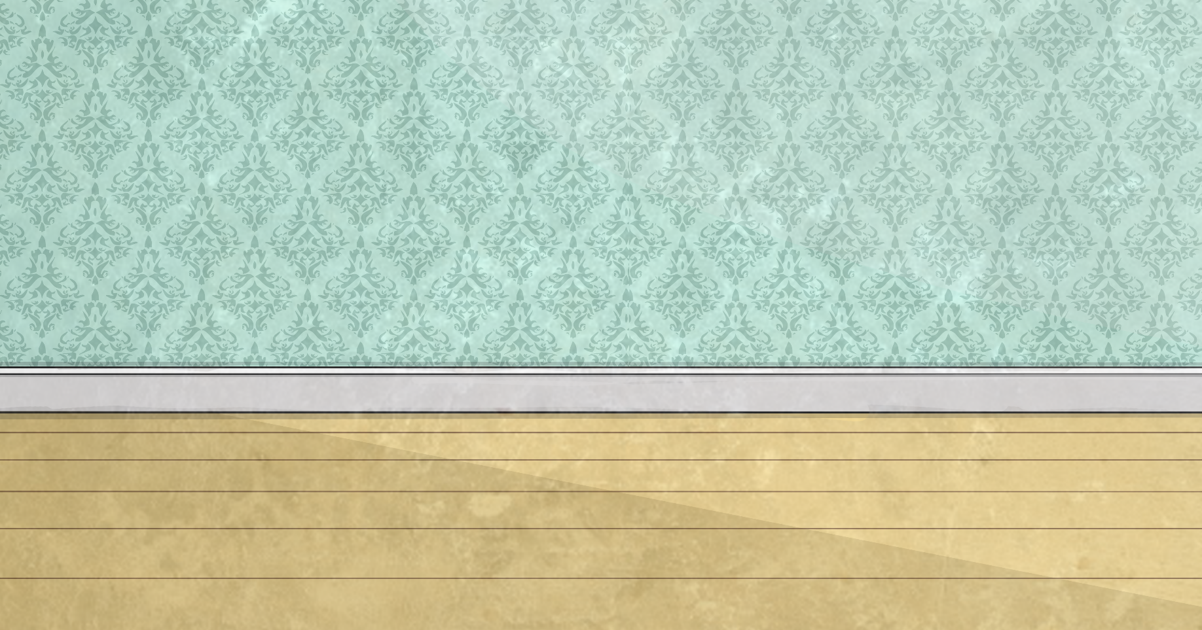
Metres to Kilometres
To convert from metres to kilometres, we divide the number of metres by 1000: 5000m ÷ 1000 = 5km
If this creates a decimal number, the thousandths become metres:
3500m ÷ 1000 = 3.500
3500m = 3km 500m

Slide 3
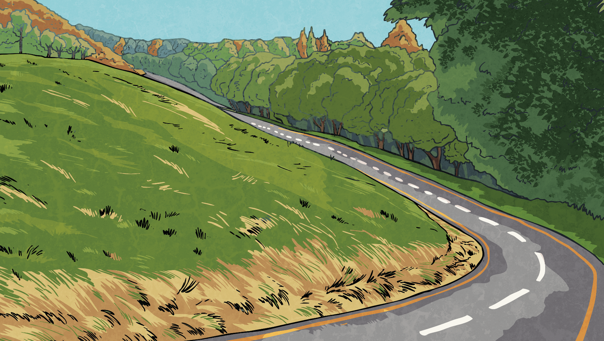
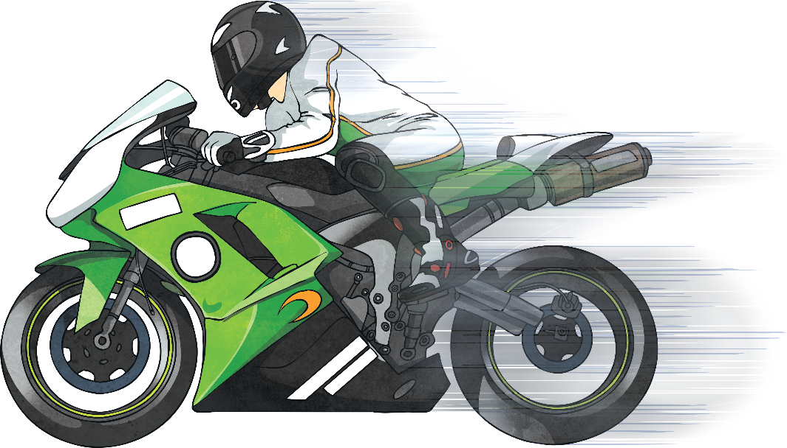
Metres to Kilometres
Convert these metre measurements to kilometres and metres.
Metres | Kilometres and Metres
6000m
4500m
6250m
8000m
2750m
3000m
9500m
6km
4km 500m
6km 250m
8km
2km 750m
3km
9km 500m

Slide 4
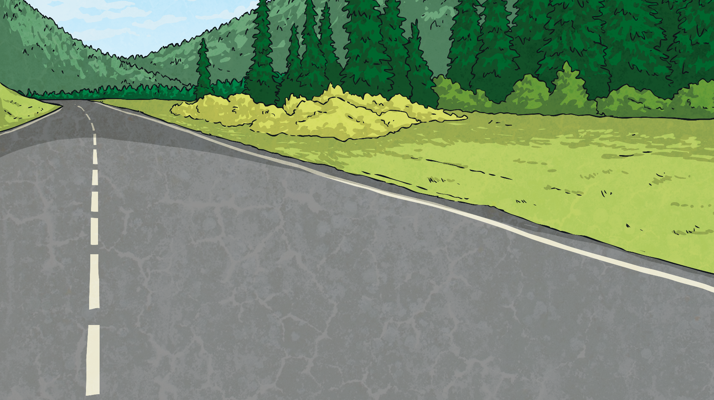
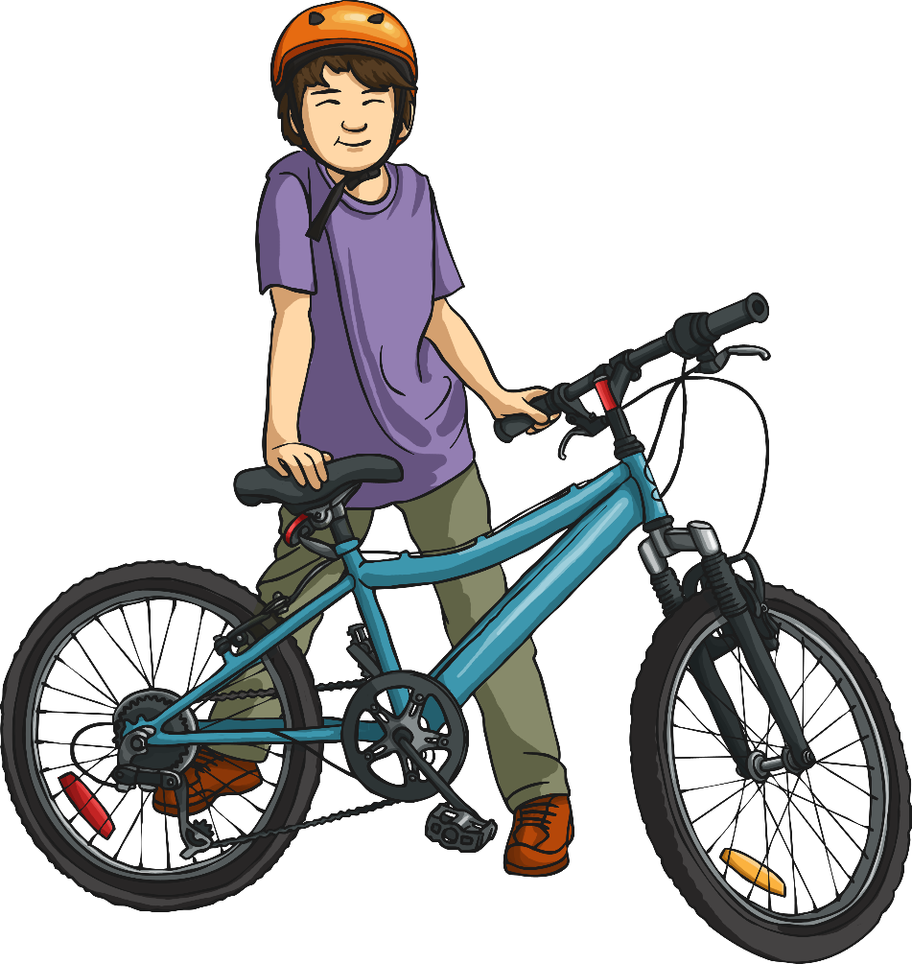
Comparing and Ordering
Use <, > or = to compare the measurements.
>
5000m |  | 3km 750m

Slide 5
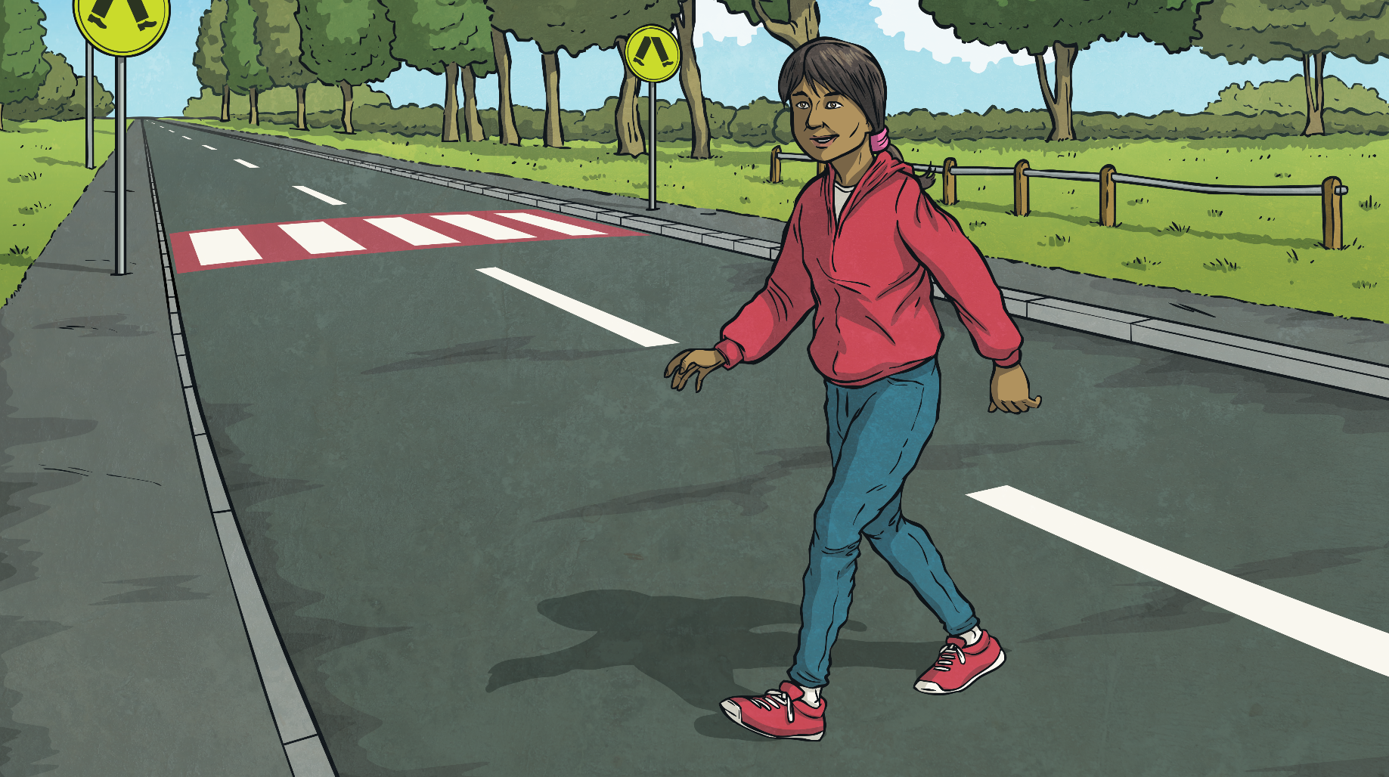
Comparing and Ordering
Use <, > or = to compare the measurements.
<
2300m |  | 4km

