Slide 2







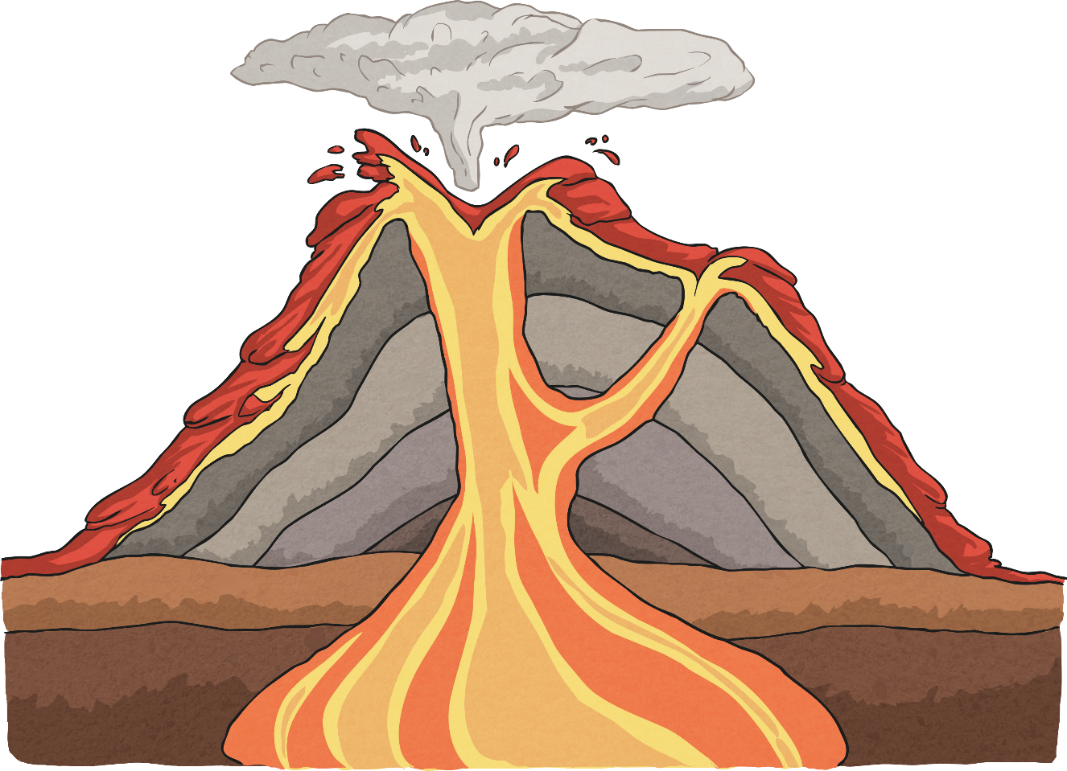
What’s It All Called?
Can you name the main parts of this volcano?
Can you explain how the grey layers were made?
eruption cloud
crater
conduit/main vent
magma chamber

Slide 3
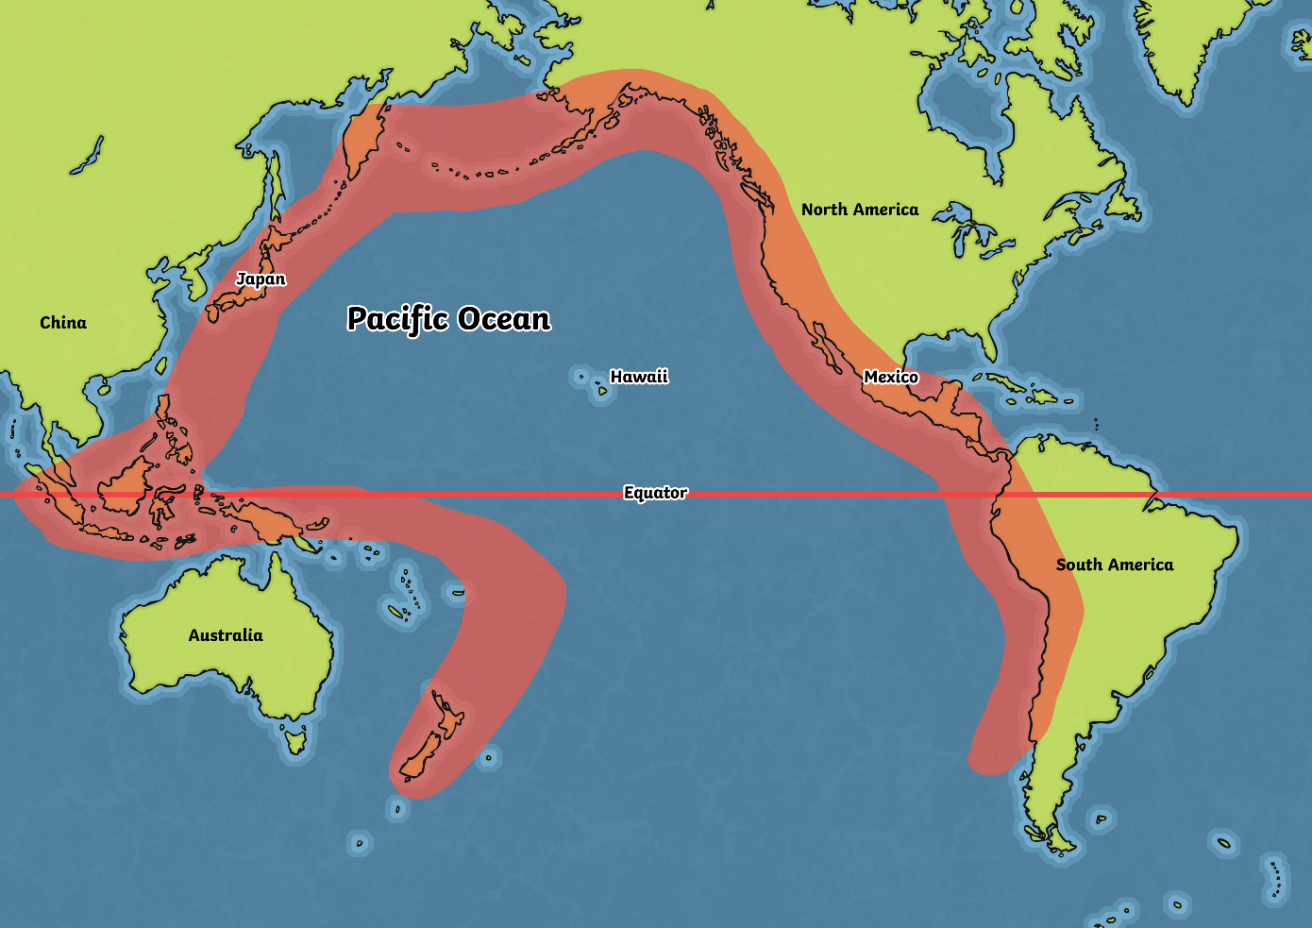
Where Are Most Volcanoes Located?
Look at this map.
Most volcanoes are located in the red area, which is named “Ring of Fire”.
Why do you think it is called that?

Slide 4
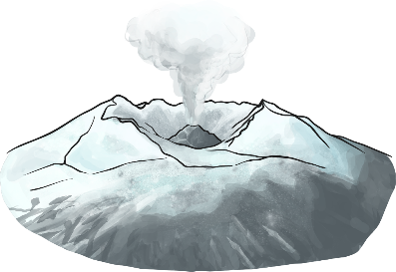
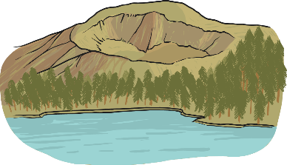
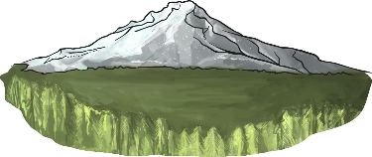
What Do They Mean?
active
A volcano that has erupted in the last 10 000 years.
dormant
A volcano that hasn’t erupted in the last 10 000 years, but may erupt again.
extinct
A volcano that hasn’t erupted in the last 10 000 years, and isn’t expected to erupt again.

Slide 5
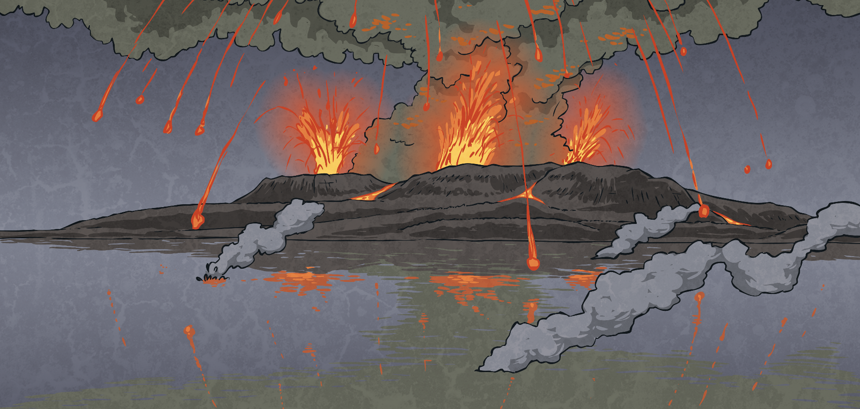
Why Do People Live
Near Volcanoes?
In your group, sort your cards into two piles:
For
Against
Which is the most important reason against?
Which is the most important reason for?
Do the risks seem worth taking?
Would you want to live near to a volcano?

